Slide 1
Types and Operators

Slide 3
Numbers

Slide 4
Operator Precedence

Slide 5
Number Precision

Slide 6
Negative Numbers

Slide 7
Strings

Slide 8
Manipulating Strings

Slide 9
Converting Strings and Numbers

Slide 10
Boolean Variables

Slide 11
null and undefined

Slide 12
Objects and Symbols

Slide 13

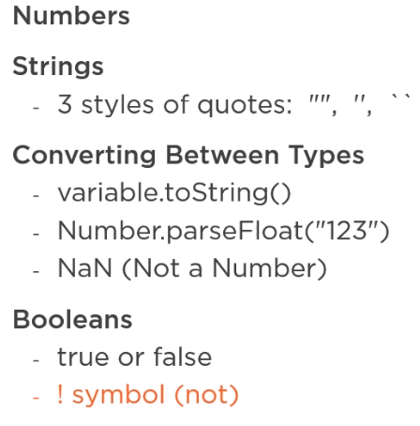
Summary

Slide 14
Summary

